Slide 1
Miss K’s Literature Class Presents…
From the creators of Spermly:
Stefan Broecker & Gleb Gorbachev.
Topics:
Prohibition
Women’s right to vote
Immigration during the 1920s

Slide 2
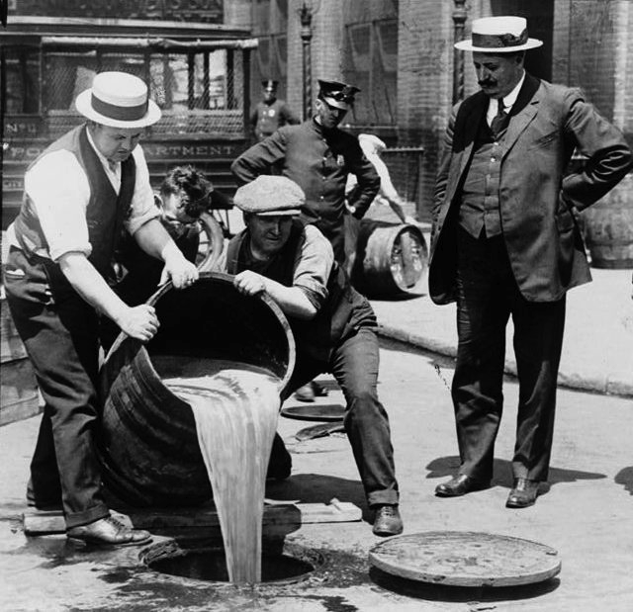
Prohibition
Prohibition was a period of nearly fourteen years of U.S. history in which the manufacture, sale, and transportation of liquor was made illegal. It led to the first and only time an Amendment to the U.S. Constitution was repealed.

Slide 3
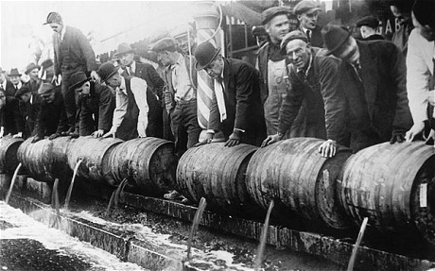
Prohibition
It was a time characterized by speakeasies, glamor, and gangsters and a period of time in which even the average citizen broke the law.

Slide 4
Prohibition
Prohibition of alcohol existed in the U.S. between 1920 and 1933. The story of how Prohibition came to be, what it was really like, and how it effects American life even today is a story of unusual ideas, fascinating characters, surprising events, and unexpected outcomes.

Slide 5
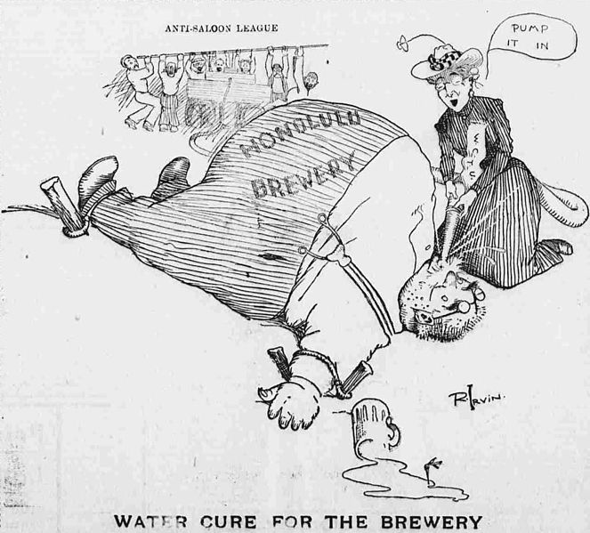
Early Years
As the Puritans loaded provisions onto the Mayflower before casting off for the New World, they brought on board more beer than water. This reflected their traditional drinking beliefs, attitudes, and behaviors-they saw alcohol as a natural and normal part of life. Their religious tradition taught them that alcohol was created by God and inherently good. Jesus had used wine and approved of its moderate consumption.

Slide 6
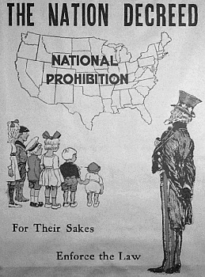
Early years
Their experience showed them that it was safer to drink alcohol than the typically polluted water. Alcohol was also an effective analgesic, provided energy necessary for hard work, and generally enhanced the quality of life. Alcohol was also thought to serve as a social lubricant, provide entertainment, facilitate relaxation, contribute to the enjoyment of food, and provide pharmacological pleasure.

Slide 7
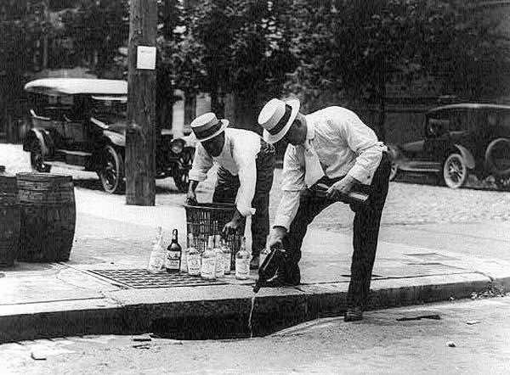
Temperance Movements
After the American Revolution, drinking was on the rise. To combat this, a number of societies were organized as part of a new Temperance movement which attempted to dissuade people from becoming intoxicated. At first, these organizations pushed moderation, but after several decades, the movement's focus changed to complete prohibition of alcohol consumption.

Slide 8
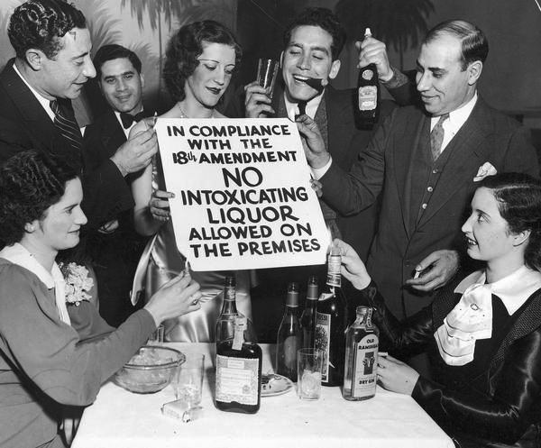
Temperance movements
The Temperance movement blamed alcohol for many of society's ills, especially crime and murder. Saloons, a social haven for men who lived in the still untamed West, were viewed by many, especially women, as a place of debauchery and evil. Prohibition, members of the Temperance movement urged, would stop husbands from spending all the family income on alcohol and prevent accidents in the workplace caused by workers who drank during lunch.

Slide 9
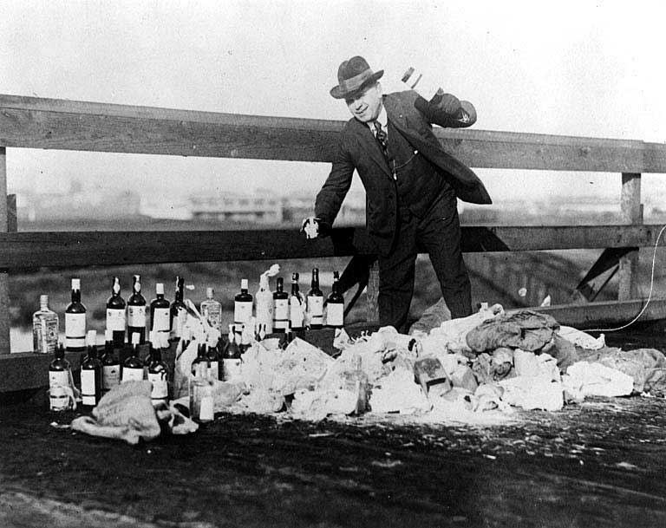
The 18th amendment passes
In the beginning of the 20th century, there were Temperance organizations in nearly every state. By 1916, over half of the U.S. states already had statutes that prohibited alcohol. In 1919, the 18th Amendment to the U.S. Constitution, which prohibited the sale and manufacture of alcohol, was ratified. It went into effect on January 16, 1920.

Slide 10
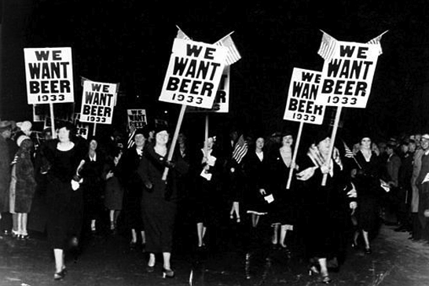
Loopholes
There were, however, several loopholes for people to legally drink during Prohibition. For instance, the 18th Amendment did not mention the actual drinking of liquor. Since Prohibition went into effect a full year after the 18th Amendment's ratification, many people bought cases of then-legal alcohol and stored them for personal use. The Volstead Act allowed alcohol consumption if it was prescribed by a doctor. Needless to say, large numbers of new prescriptions were written for alcohol.

Slide 11
Attempts to Repeal the 18th Amendment
Almost immediately after the ratification of the 18th Amendment, organizations formed to repeal it. As the perfect world promised by the Temperance movement failed to materialize, more people joined the fight to bring back liquor. The anti-Prohibition movement gained strength as the 1920s progressed, often stating that the question of alcohol consumption was a local issue and not something that should be in the Constitution.
Additionally, the Stock Market Crash in 1929 and the beginning of the Great Depression started changing people's opinion. People needed jobs. The government needed money. Making alcohol legal again would open up many new jobs for citizens and additional sales taxes for the government.

Slide 12
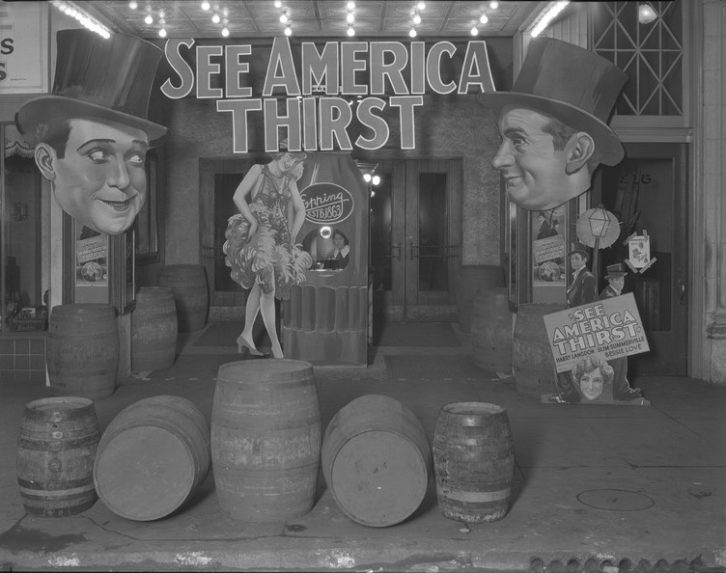
The 21st Amendment Is Ratified
On December 5, 1933, the 21st Amendment to the U.S. Constitution was ratified. The 21st Amendment repealed the 18th Amendment, making alcohol once again legal. This was the first and only time in U.S. history that an Amendment has been repealed.

Slide 13
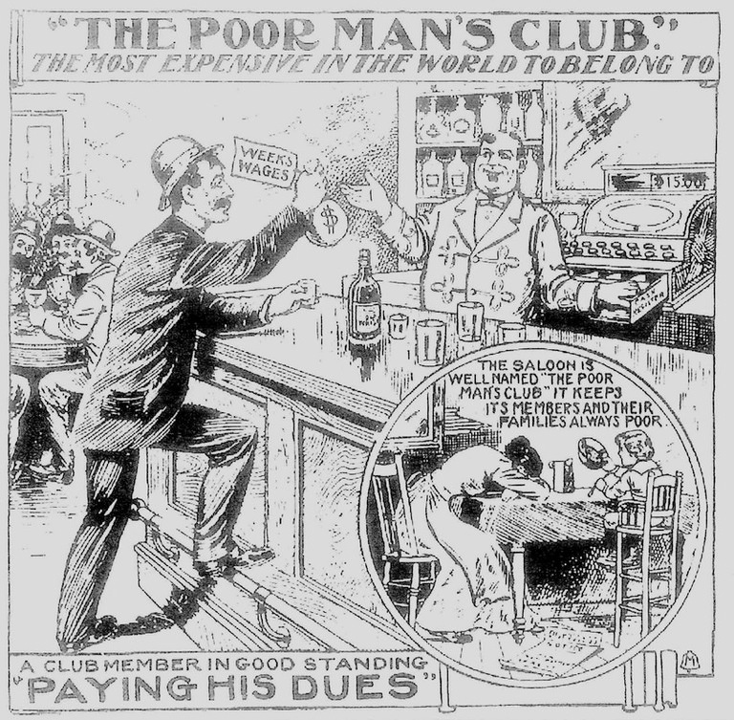
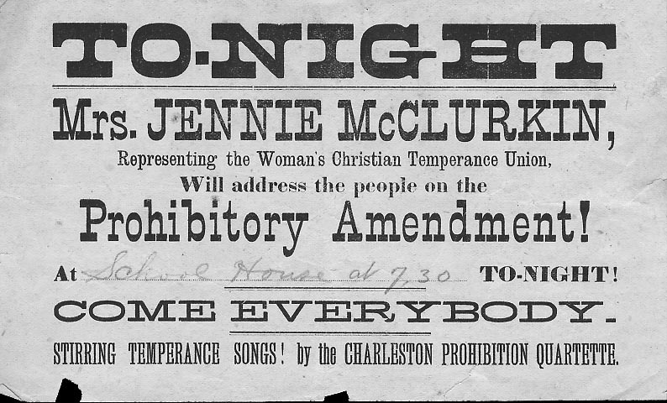
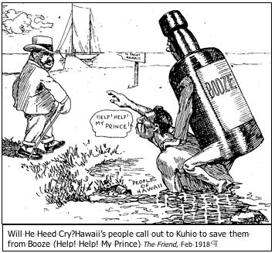
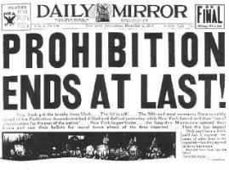
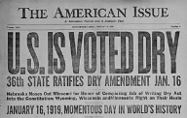
Anti-saloon League
The Anti-Saloon League, the leading organization for National Prohibition in the United States, was a non-partisan political pressure group established in 1893. It was a single-issue lobbying group that had branches across the United States to work with churches in marshaling resources for the prohibition fight. Its primary base of support was among Protestant churches in rural areas and the South.
The Ku Klux Klan (KKK) was a major supporter of Prohibition.

Slide 14
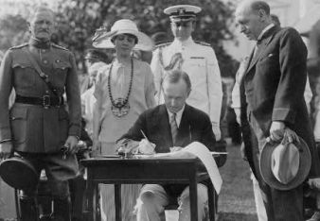
The immigration situation during the 1920s
The Immigration Act of 1924, or Johnson–Reed Act, was a United States federal law that limited the annual number of immigrants who could be admitted from any country to 2% of the number of people from that country who were already living in the United States in 1890

Slide 15
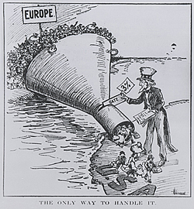
The immigration situation during 1920s
Immigration restriction became a favored method for nativists and special interests in the "clash of cultures" at the turn of the century. While few restrictions prevented immigration to the U.S. before 1900, interest groups did succeed in pressuring the federal government to exclude unwelcome immigrants - prostitutes (originally Asian women), convicts, contract laborers, the mentally ill, and the diseased - and in some cases the government imposed a head tax on new arrivals.

Slide 16
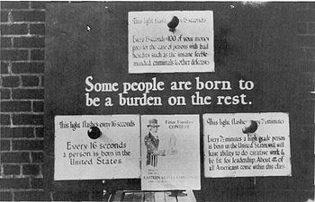
The immigration situation during 1920s
By the early twentieth century, organized labor, nationalist and nativist organizations, temperance organizations and, at various times, farmers and manufacturers, lobbied Congress to regulate the flow of "new" immigrants by imposing literacy requirements. Twenty years after it was first proposed, Congress finally passed (over President Wilson's veto) a law in 1917 that required literacy tests for new immigrants . The First World War slowed immigration to the U.S. but, after the armistice, mass immigration resumed, reaching 805,000 in 1921.

Slide 17
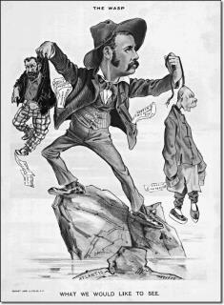
The immigration situation during 1920s
Various events after World War I, such as the recession of 1920 to 1921, the First Red Scare, the resurgence of the Ku Klux Klan, the furor surrounding the trial of Sacco and Vanzetti, and organized opposition to immigration intensified the "clash of cultures." The Emergency Quota Act of 1921 limited immigration to three percent of the number of immigrants of any particular country that had been living in the United States in 1910, which only partially stemmed the flow.

Slide 18
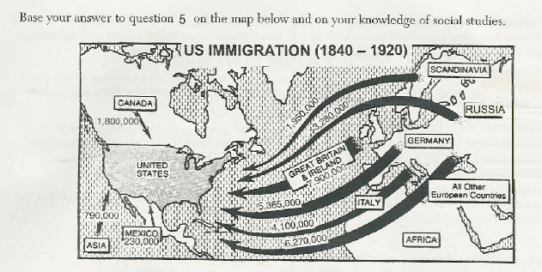
The immigration situation during 1920s
Nativists not only objected to the numbers of immigrants, but also to the potential impact newcomers would have on “traditional American values”. During the late nineteenth and early twentieth century, nativist groups such as the American Protective Association, the Immigration Restriction League, and the Ku Klux Klan buttressed their demands for restriction with "scientific" arguments.

Slide 19
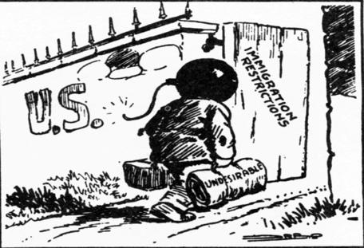
The immigration situation during 1920s
They often employed eugenics to prove the "inferiority" of Asians and "new" immigrants from southern and eastern Europe, mostly Catholics and Jews. Even academics, clerics, and intellectuals feared the mixing of old stock Europeans and Americans with the so-called "backward races" of southern and eastern Europe -- a condition, they believed, that could only lead to "race suicide" and "reversion" to a more primitive state.

Slide 20
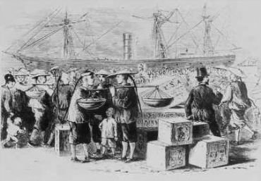
The immigration situation during 1920s
Cultural assimilation, also known as Americanization, was a less drastic means of dealing with the numerous ethnic enclaves in American cities. While restrictionists rejected immigrants entirely, assimilationists believed that immigrants could adapt to the American way of life. The Immigration Protective Association, the International Ladies Garment Workers Union, the Amalgamated Clothing and Textile Workers Union, and representatives of the settlement house movement aimed at helping immigrants shed or at least diminish their Old World cultural roots and become "Americans."

Slide 21
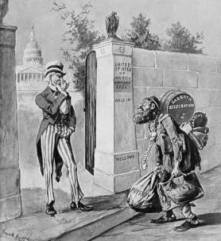
The immigration situation during 1920s
Three years later, Congress passed a more stringent law, the Immigration Act of 1924, by an overwhelming majority. This law restricted new arrivals to just two percent of foreign-born residents according to the Census of 1890, when the number of "new" immigrants was relatively small. As a result, immigration law all but eliminated the flow of immigrants from southern and eastern Europe, and it effectively excluded all immigration from most of Asia until World War Two.

Slide 22
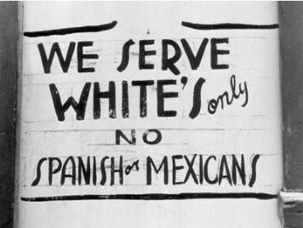
The immigration situation during 1920s
By 1928 immigration had declined to about 300,000, and just over a half million new arrivals entered the U.S. during the entire decade of the 1930s. It was a victory of sorts for those who thought they could protect American culture and institutions by keeping out new and different peoples.

Slide 23
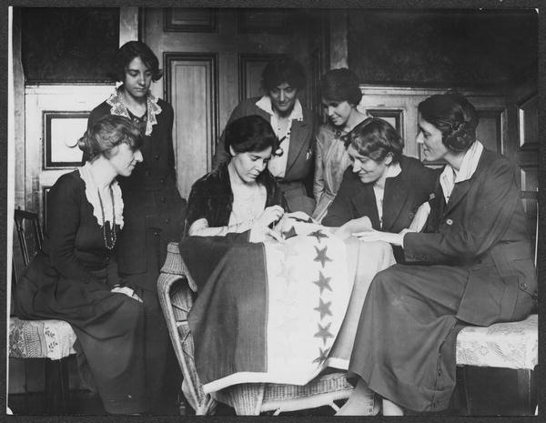
Suffrage
AMENDMENT XIX
The right of citizens of the United States to vote shall not be denied or abridged by the United States or by any state on account of sex.
Congress shall have power to enforce this article by appropriate legislation.

Slide 24
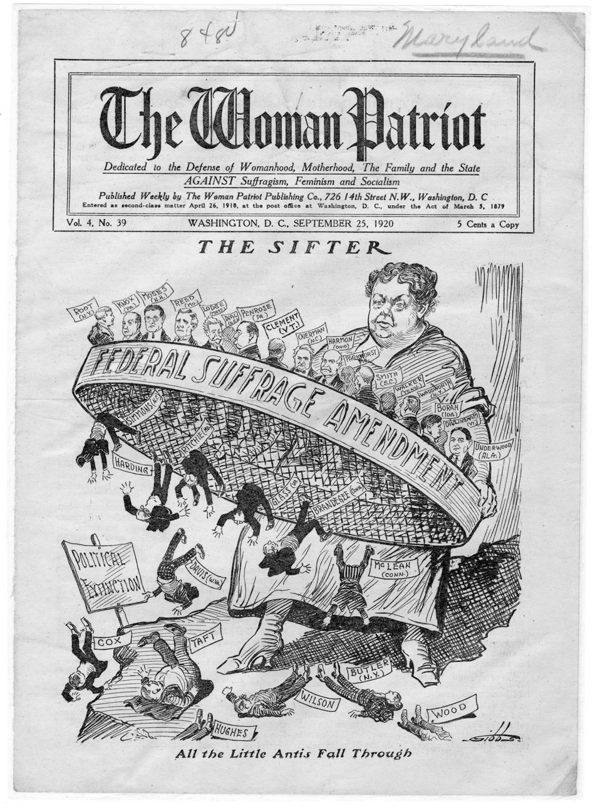
Suffrage
It was not until 1848 that the movement for women's rights launched on a national level with a convention in Seneca Falls, New York
Four years later, at the Woman's Rights Convention in Syracuse in 1852, Susan B. Anthony joined the fight, arguing that "the right women needed above every other...was the right of suffrage."

Slide 25
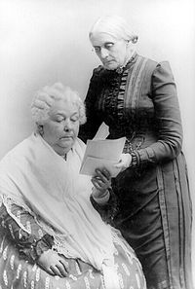
Suffrage
Susan B. Anthony and Elizabeth Cady Stanton form the National Woman Suffrage Association in 1869. The primary goal of the organization was to achieve voting rights for women by means of a Congressional amendment to the Constitution.
During debates on the Reconstruction Amendments which extended the vote to ex-slaves (through the 15th Amendment), suffragists pushed hard for "universal suffrage," but they never had a chance.

Slide 26
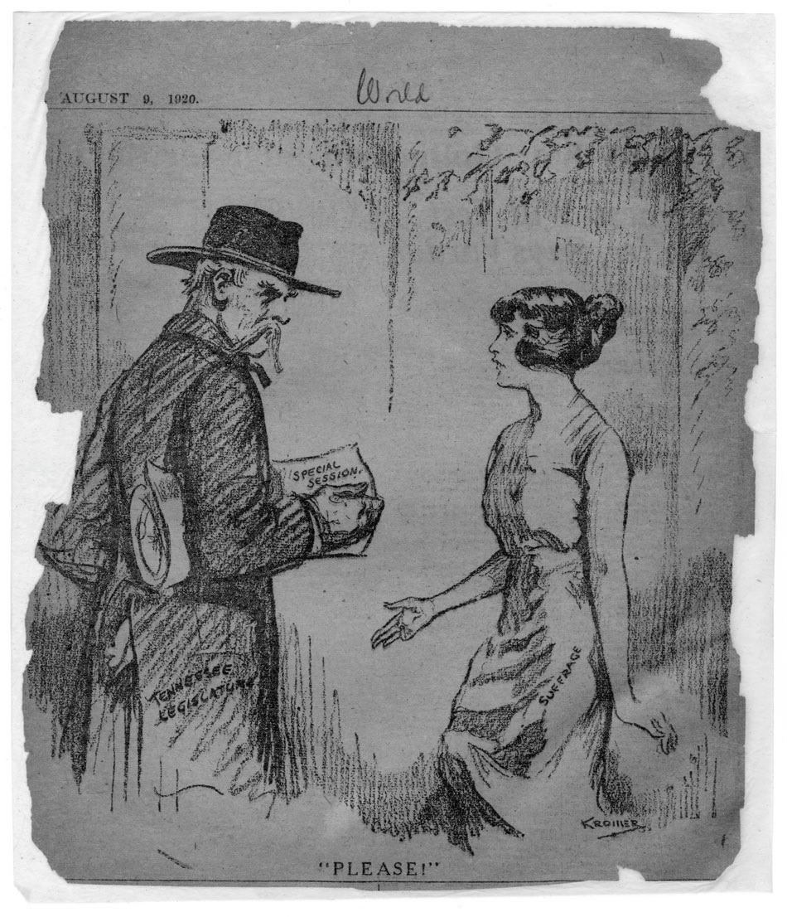
Suffrage
The first case to make its way to the Supreme Court, was Minor vs Happersett (1875). In Minor, a unanimous Court rejected the argument that either the privileges and immunities clause or the equal protection clause of the 14th Amendment extended the vote to women. Following Minor, suffragists turned their attention from the courts to the states and to Congress.

Slide 27
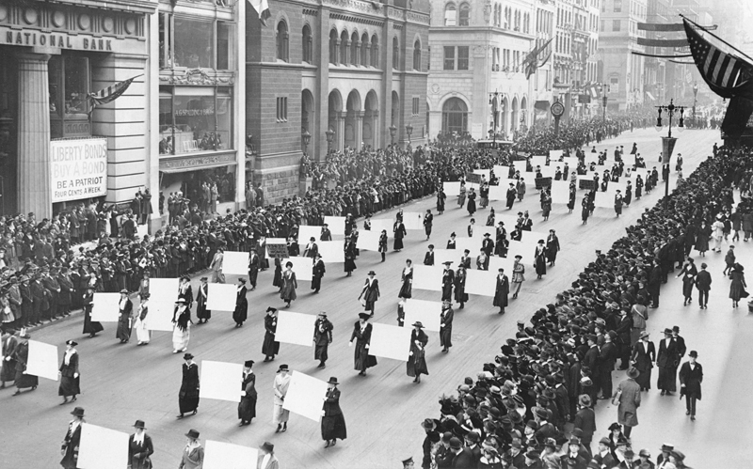
Suffrage
In 1912, Theodore Roosevelt's Progressive (Bull Moose) Party became the first national political party to have a plank supporting women suffrage.
In May, 1919, the necessary two-thirds vote in favor of the women suffrage amendment was finally mustered in Congress, and the proposed amendment was sent to the states for ratification

Slide 28
The lost generation
During the 1920's a group of writers known as "The Lost Generation" gained popularity. The term "the lost generation" was coined by Gertrude Stein who is rumored to have heard her auto-mechanic while in France to have said that his young workers were, "une generation perdue". This refered to the young workers' poor auto-mechanic repair skills. Gertrude Stein would take this phrase and use it to describe the people of the 1920's who rejected American post World War I values.

Slide 29
The lost generation
The three best known writers among The Lost Generation are F. Scott Fitzgerald, Ernest Hemingway and John Dos Passos. Others among the list are: Sherwood Anderson, Kay Boyle, Hart Crane, Ford Maddox Ford and Zelda Fitzgerald. Ernest Hemingway, perhaps the leading literary figure of the decade, would take Stein's phrase, and use it as an epigraph for his first novel, The Sun Also Rises. Because of this novel's popularity, the term, "The Lost Generation" is the enduring term that has stayed associated with writers of the 1920's.

Slide 30
The lost generation
If you want to read into the 1920s – read these:
--T.S. Eliot (poet)
--F. Scott Fitzgerald ("The Great Gatsby")
--D.H.Lawrence ("Lady Chatterley's Lover")
--Robert Frost (poet)
--Agatha Christie ("Murder on the Orient Express")
--Edith Wharton ("The Age of Innocence")
--Eugene O'Neill (playwright--wrote "A Long Day's Journey Into Night")
--Hart Crane (poet)
--Ezra Pound (poet)
--Edna St. Vincent Millay (poet)
--H.G. Wells ("The War of the Worlds")
--Ernest Hemingway ("The Old Man and the Sea")
--Gertrude Stein ("The Autobiography of Alice B. Toklas")
--Sinclair Lewis ("Main Street")
--H.L. Mencken ("The American Language")

Slide 31
Great sources to read
http://www2.potsdam.edu/hansondj/Controversies/1091124904_7.html - Prohibition
http://ehistory.osu.edu/osu/mmh/clash/imm_kkk/Immigration%20Pages/Immigration-page3.htm - Immigration

