Slide 1
The Roaring 20‘s
By Helen and Alisa

Slide 2
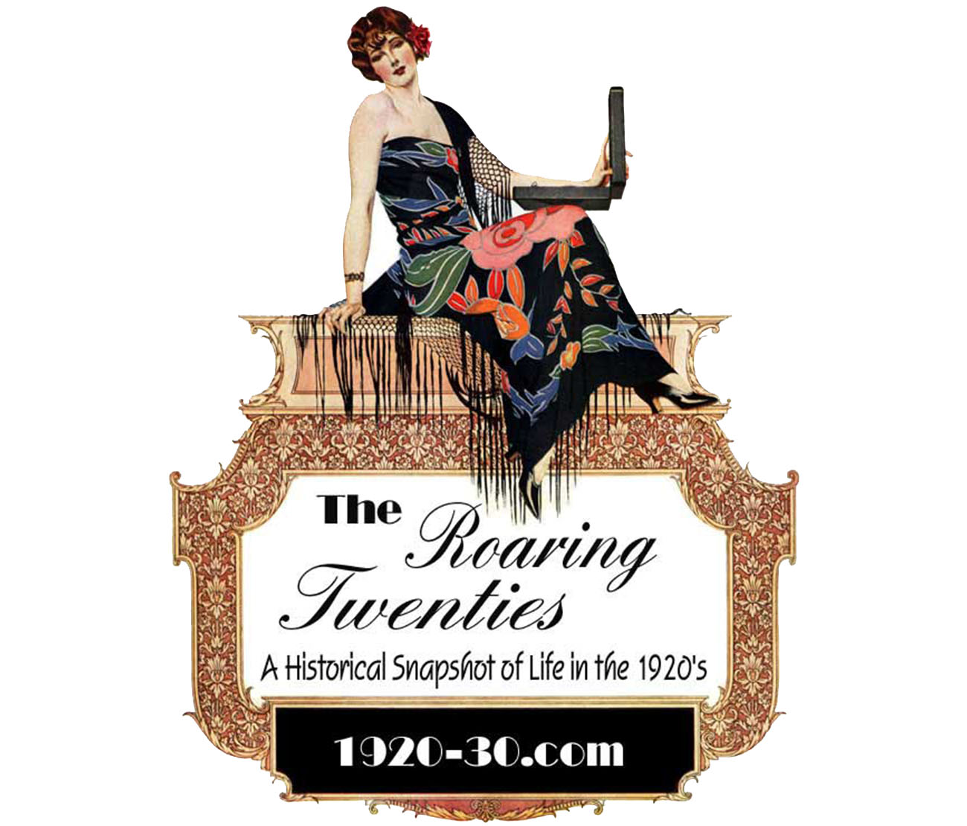
Context- events leading up to it
Industrialization, beginning with and because of WW1
USA is least affected World Power
Economic Boom; wild speculationso on stock markets
Black Friday (Wallstreet crash) in 1929
Mass unemployment- middle class has loss of their fortunes
Roosevelt closes „New Deal“
Hitler erects Nazi Germany
Russia becomes communist
From 1920-1929

Slide 3
The Roaring 20‘s
Characterized by:
Rapidly changing lifestyles
Financial excesses
Fast pace of technological progress
Entire new economies such as mobility, media communication and mass production
World wide new ways of expression
Rejecting the pre war habits and structures jazz, dance theatre, fashion but also drug consumption, free body culture and sexual liberation occured as a mass phenomenom.

Slide 4
End of WW1
Hirarchical society to society of common interests
Politics
20
Society
Research
Military engineering
Trauma of Verdun
Psychological warfare
Desorientation
Dissolution of cities
Definition by group interests
Desire for social affiliation
Desire for new expression
Economy
International cooperations
Entertainment Industry
Electrification/Motorization/Mechanization

Slide 5
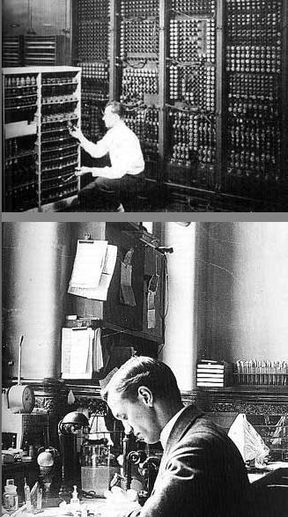
Research/ Innovations in the 1920‘s
Mobility
Airplanes
Naval architecture
Motor vehicles
Mechanical engineering
Tunnels
High rise buildings
Medicine
Psychology/ Trauma research
Bacteriology
Physics
Beginn of atom physics (Otto Hahn)
General theory of relativity (Albert Einstein)
Radiology (Marie Curie)
Telecommunication engineering
Radio
Cinema
Film
Newspapers
Telephone
Telegram

Slide 6
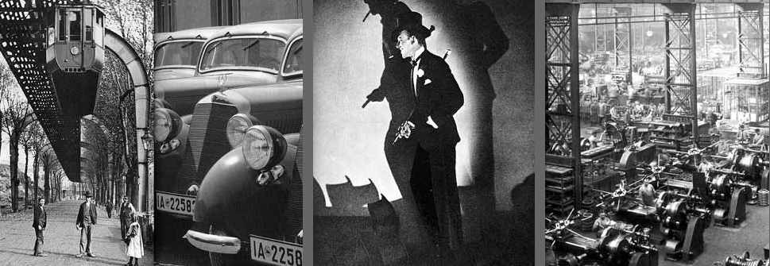
Economy in the 1920‘s
Electrification/Motorization/Mechanization
Loop Chicago
Subway
Metro
Entertainment Industry
Film-Hollywood, UFA
Media
Newspaper publishers
News agencies
Radio stations
International cooperations
Siemens
Krupp
Mercedes
AEG

Slide 7
Society in the 1920‘s
Elitist pleasure
Dance floors
Cabarets
Mass culture
Art and culture reached the mass
Desire for Pleasure
Distraction, Amusement and excitement
Avantgarde
Internationally open
International style
Revealing experimenting
Women appear more masculine
Exotic eroticism
New artistic expression

Slide 8
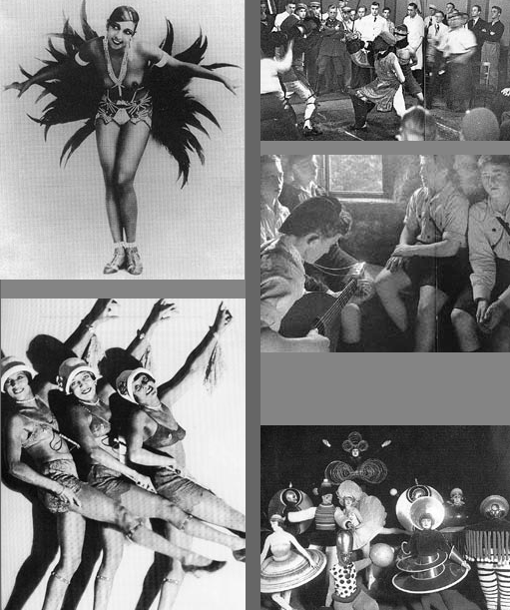
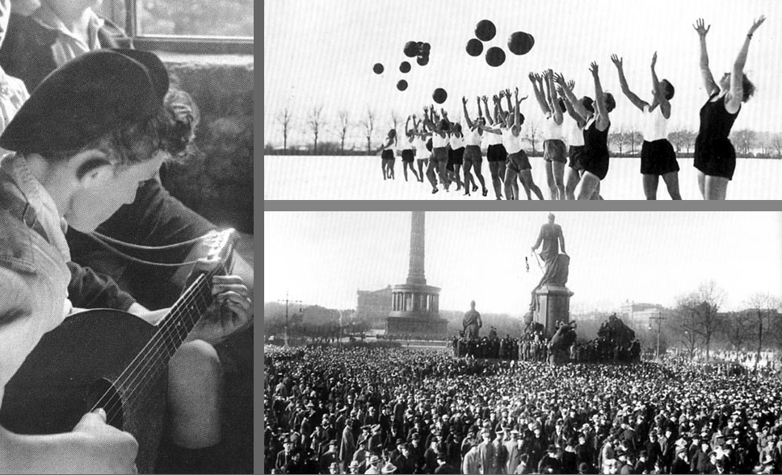
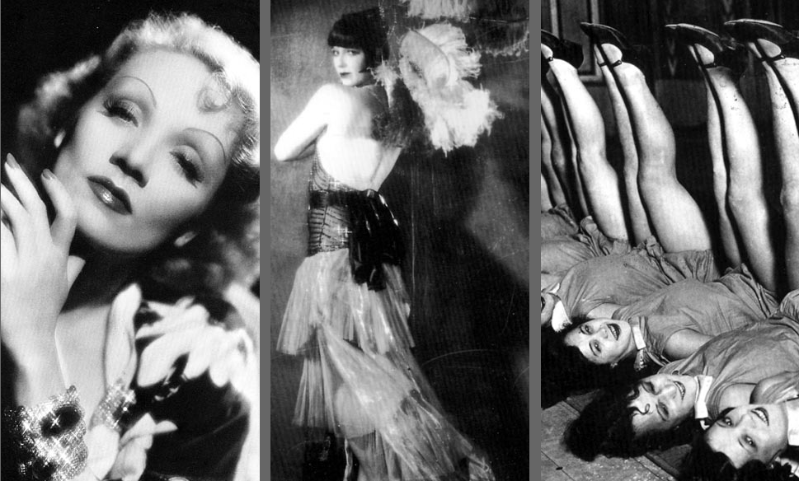

Slide 9
Fashion
Expression of Society
New self esteem of women
New handling of sexuality
Homosexuality
Working women
Driving cars
Doing sports
Academic studies
Formal influences
Clear design
Straight lines
Functional

Slide 10
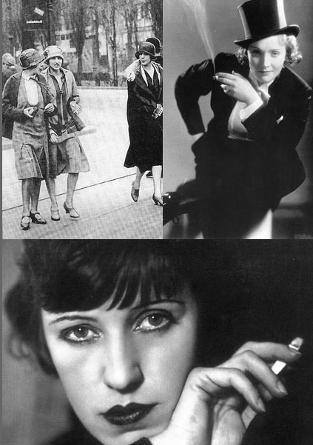
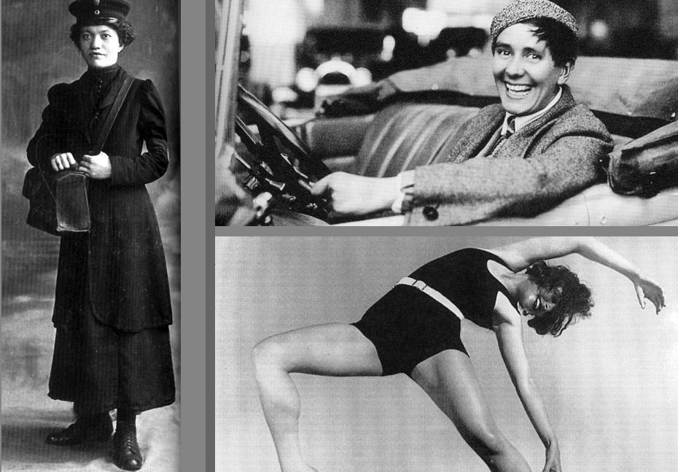

Slide 11
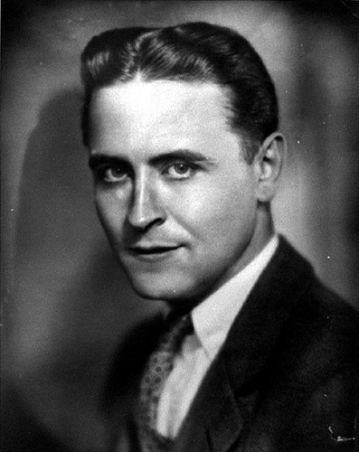
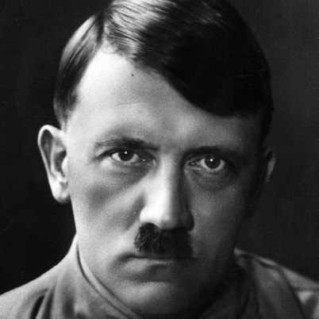
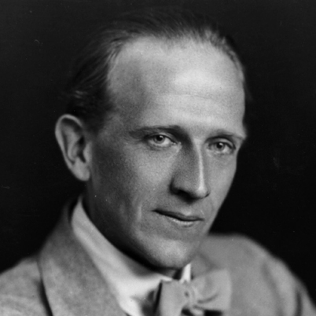
Writers
F.Scott Fitzgerald
The Great Gatsby
1925
Portrayed people who became successful in social and financial worlds, but didn’t share the same property in their morals
Adolf Hitel
Mein Kampf
1925
Autobiography
A.A Milne
Winnie the Pooh
1926
A fictional bear named after the author’s son teddy bear

Slide 12
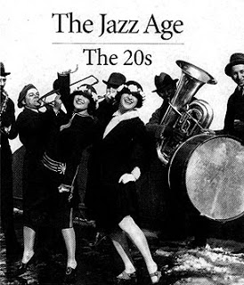
Artists
The Jazz Age
(Jazz was born in New Orleans)
Marion Harris
first white widely known jazz and blues singer
Vernon Dalhart
major influence in the field of country music
Mamie Smith
the first African American to make a blues recording
Eck Robertson
became the first country musician to be recorded
Louis Daniel Armstrong
Trumpeter, cornet player, singer

Slide 13
Architecture
Upgrade of low cost housing
Homes are more affordable
Introduction of agencies (home planing, building, financing)
Invention of new materials
easier to cool and heat
more hygenic
More suited to modern living
Tudorbethan Style
The construction was either brick with surface treatments or wood-frames with brick infill
Bungalow
Development of steel
Skyscraper
invention of the elevator

