Slide 1
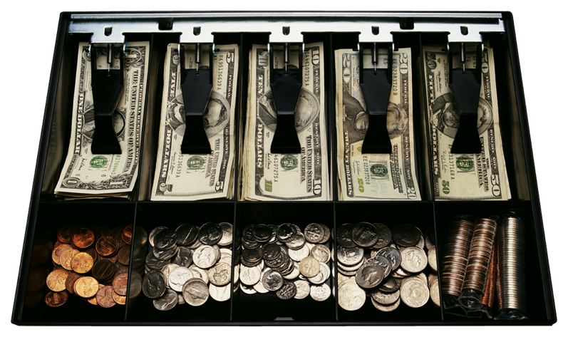
The Wall Street Crash & the great Depression
Constanze & Victoria

Slide 2
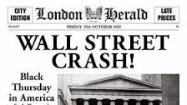
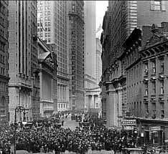
What was The wall street crash ?
U.S. Stock Market Crash of October 29, 1929 → World wide collapse of share values leading to the Great Depression
1st day of panic was the October 24th → Black Thursday
Followed by “Black Monday“ and “Black Tuesday“ → October 29th

Slide 3
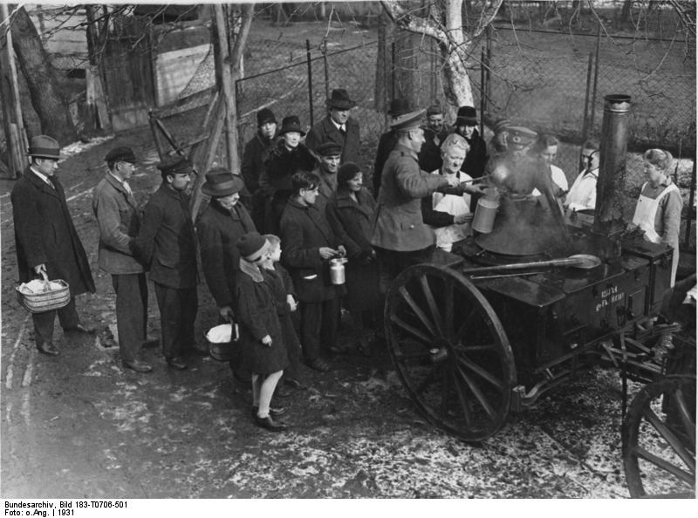
the weimar republic
Weimar Republic was devastated by Wall Street Crash and Great Depression
America helped Weimar Republic with loans earlier → economy impacted
America gave Germany 90 days to repay loans
Companies went bankrupt
September 1928 | 650.000 unemployed
September 1929 | 1.320.000 unemployed
September 1930 | 3.000.000 unemployed
September 1931 | 4.350.000 unemployed
September 1932 | 5.102.000 unemployed
January 1933 | 6.100.000 unemployed

Slide 4
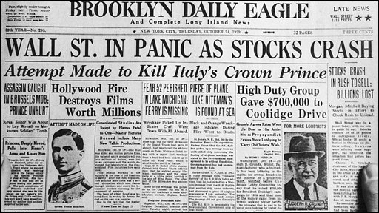
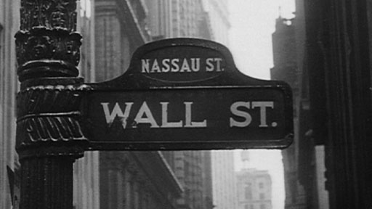
Economics as a cause
Various economic imbalances
Structural failings

Slide 5
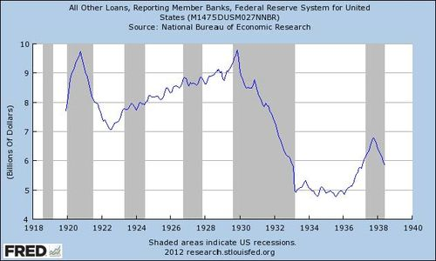
Credit boom
1920s rapid growth in loans and bank credit
People became highly indebted → change in confidence
Borrowers were exposed and joined rush to sell shares and redeem debts

Slide 6
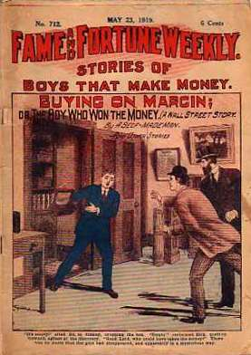
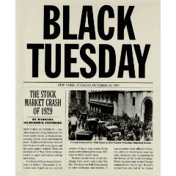
Buying on the margin
Buying shares on margin
= only have to pay 10% - 20% of value of shares → borrowing 80% - 90% of value of shares
Enabled more money to be put into shares, increasing values → “margin millionaire investors“
Huge profits

Slide 7
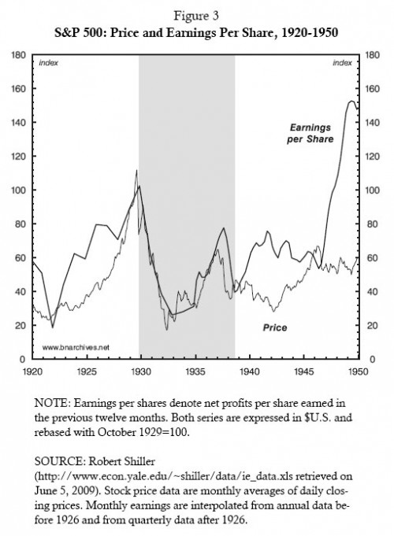
Irrational exuberance
Over exuberance and false expectations
Stock market offered potential for making gains in wealth
→ people bought shares
Share prices rose, people borrowed money to invest
Market got caught in speculative bubble
Problem → stock prices became divorced from real potential earnings of market shares
Prices were driven by investors not by economic fundamentals

Slide 8
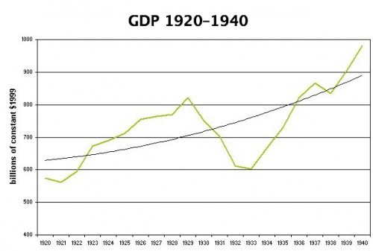
Mismatch between production and consumption
1920s great strides in prodcution techniques
Enable economies of scale and increases in production
Demand for consumer goods was not maintained
Not all produced goods were sold
Disappointing profit results

Slide 9
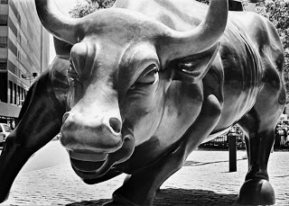
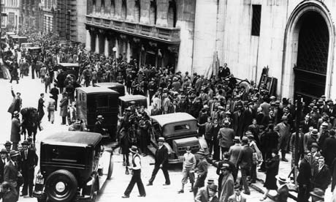
Weaknesses of banking systems
Many small to medium sized firms
Over 30.000 banks
Susceptible to going bankrupt if there was a run on deposits
Banks in rural areas went bankrupt because of agricultural recession
→ 5000 banks collapsed

Slide 10
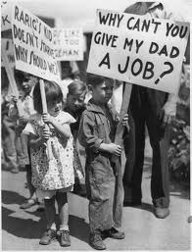
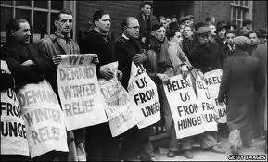
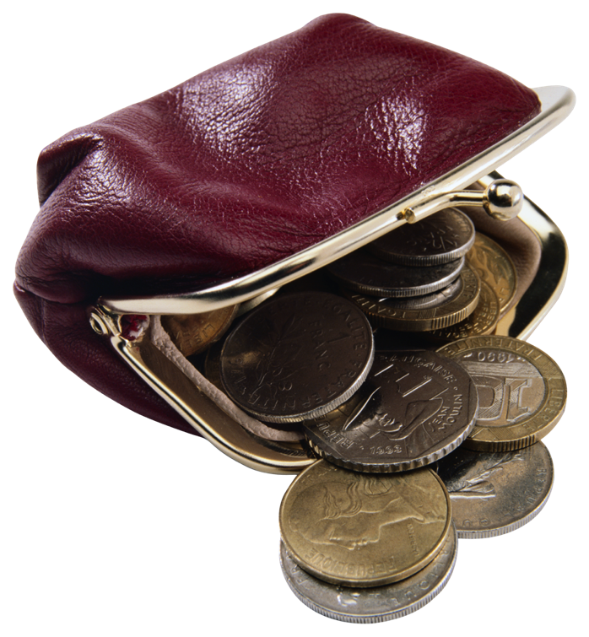
Results of Wall street crash
Bankruptcies and major unemployment spread around the world
Beginnings of the Great Depression
Dust Bowl → draught and dust storms

Slide 11
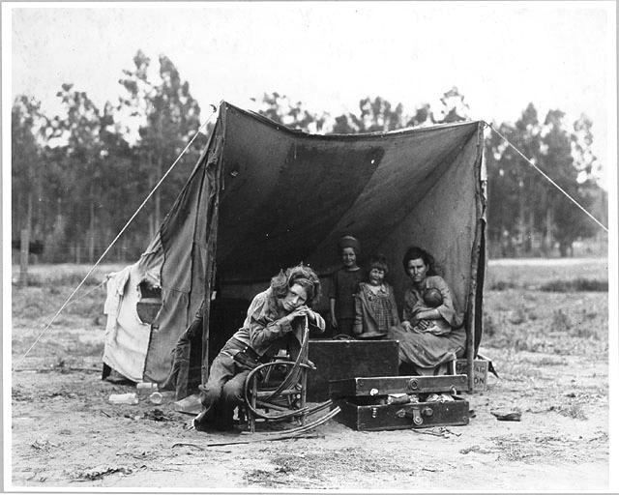
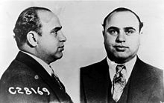
The era
March 22nd 1933 → President Franklin Roosevelt legalized alcohol content of 3.2 %
December 5th 1933 → Prohibition fully repealed
Many migrant workers in America → only earned 5 $ per day and had terrible living conditions

Slide 12
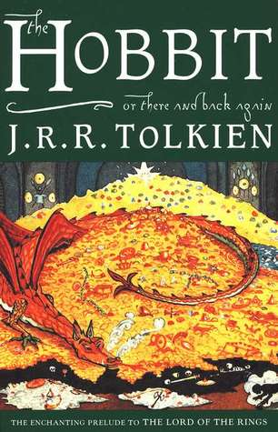
Famous writers A collection of authors and books published 1930 - 1939
As I Lay Dying – William Faulkner (1930)
Brave New World – Aldous Huxley (1932)
Tender Is The Night – F. Scott Fitzgerald (1933)
The Hobbit – J.R.R Tolkien (1937)
Rebecca – Daphne du Maurier (1938)
The Grapes Of Wrath – John Steinbeck (1939)

Slide 13
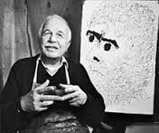
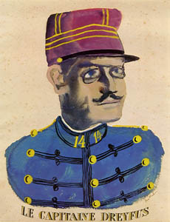
Artists & Works Ben Shahn (1898- 1969)
Born in Lithuania
Emigrated to New York 1906
Became part of the social realism movement
Social Realism: Works of American artists during the depression
era that focused on the social troubles of the suffering urban
lower class
Dreyfus affair painting

Slide 14
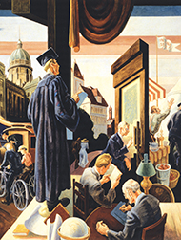
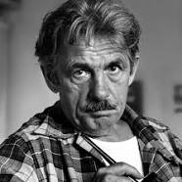
Artists & Works Thomas Hart Benton (1889-1975)
Best known muralist associated with the American Scene Painting Movement of the 1930s.
Indian Murals is his most famous and most controversial work
Regionalist style of painting / focus on social commentary

Slide 15
Architecture Foursquare style

Slide 16
Inventions
Clarence Birdseye →Frozen foods (1931)
Ruth Wakefield → Chocolate Chip Cookie (1931)
Charles Darrow → Monopoly (1933)
Charles Richter → Richter Scale (1934), to measure strength of earthquakes
Wallace Carothers → Nylon (1935)
Karl Landsteiner → Discovered blood types (1937)
Chester Carlson → Photocopier (1938)
Nestle → Instant Coffee (1939)
Electric guitar → Went on the market (1939)

Slide 17
Thanks for listening

